Slide 1
FIND
By Qurrat ulain

Slide 2


Project Overview
The app aims to facilitate the process of finding missing people in Regina
The user will be able to look through a database of missing / wanted people in Regina, ordered in a descending date format.
As well, the app will have a knowledge aspect to it that will address some of the underlying themes and issues targeting vulnerable people in Regina such as poverty and racism

Slide 3
Project Conception – UN Sustainable Goals
In 2018, 1 in 3 trafficking victims were children, and this has been increased due to the pandemic
The pandemic has also led to the loss of jobs for millions of workers, with a jump in unemployment rate to 13% from 7%
As popular research shows, people that are economically and socially disadvantaged are overrepresented among the people reported missing compared to the general population.

Slide 4
Project Conception – UN Sustainable Goals
Providing users with an easy and accessible way to access information they would have to research otherwise is just as important as providing them with a way to help their community by using the database.
This application will not only make it easy for people to get involved in the search for the missing, but it will also provide them with an easy way to learn about why social exclusion can lead to higher cases of missing persons and what the general population can do to help

Slide 5
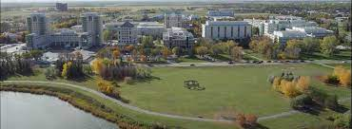
Project Conception – Community - Regina
I found Regina to be stable and open to new technologies, and so it would not be too disruptive to introduce another one.
Regina is pretty diverse, with a varied racial composition but the majority of citizens being white.
The level of participation in the city is also very diverse, with lots of opportunities to volunteer and different kinds of job opportunities.

Slide 6
Project Conception – Community Orientations
The Regina community shares a majority of their information through social media, local news or the newspaper.
The second major orientation of the community was through Relationships and Open-Ended Conversations, or more specifically, word of mouth.
I also encountered other community orientations such as individual participation, service content and access to expertise, all of which are very active in the Regina community, but I chose to focus on the first two because I was able to easily integrate them into my application.

Slide 7
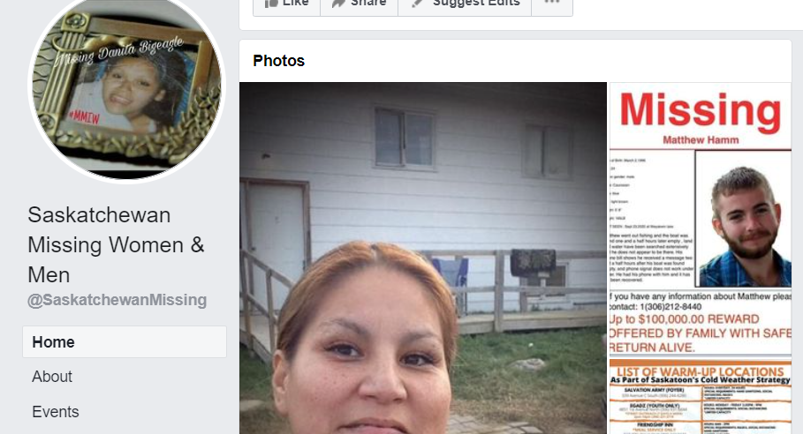
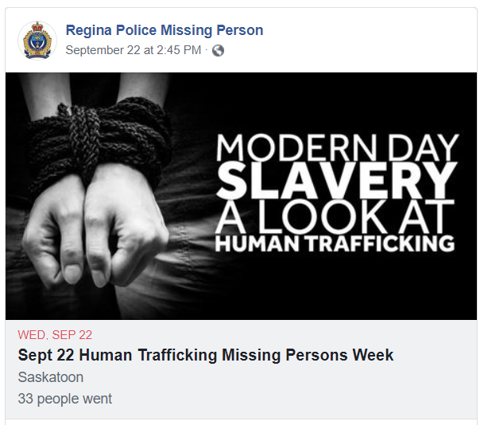

Project Conception – Tech Configuration Inventory
There were especially lots of resources across Canada, including the Missing People Canada website, Missing Children’s Society Canada (who had both a website and an app), as well as a number of Facebook groups surrounding the search for Missing people.

Slide 8

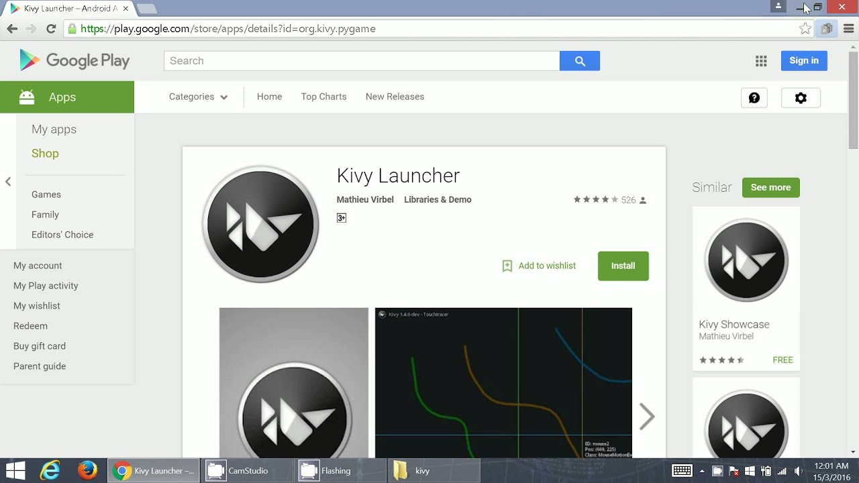

Project Development – Softwares Used
KivyMD
Python
Kivy Launcher

Slide 9
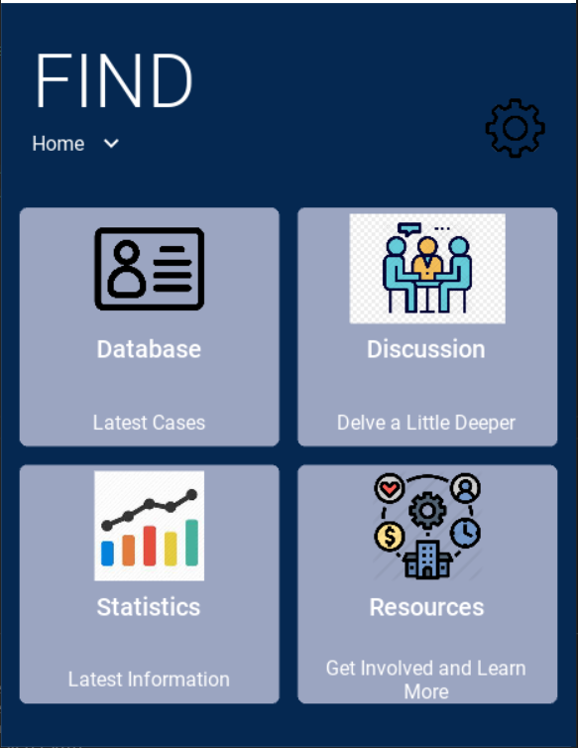
Project Development - Demo

Slide 10
Post-Project - Reflection
I enjoyed working on this project, I believe it was successful even if I wasn’t able to create exactly what I had previously envisioned. I liked trying out and learning a new program (Kivy) and I liked that it challenged me to develop my skills.
Throughout the project experience, I was the most proud of my vision for the project. I enjoyed creating something that I could eventually see helping people in many communities.
The biggest thing I learned throughout this project was the importance of researching the software you plan on using to create your application extensively before working with it.

Slide 11
Post-Project - Reflection
Working with clients is a big part of being a software engineer and designing this application with the main target being to help people was a very eye-opening experience.
For the future, I would like to evolve this project to be completely automated, so it involves as little human involvement as possible.
I would like it to update its data automatically from the Regina Police’s Missing Persons database, and same with the case details and articles.
I also didn’t end up implementing a notifications customization option, but I think users should be able to choose the case or discussion they want to keep notifications turned on for.

